Slide 1
Performance & Power Management
TMA Training Center (TTC)
Course | iPhone application development
Trainer | Thuong Tran
Designed by | TMA Mobile Solutions (TMS)
Last updated | 25 Mar 2011

Slide 2
This section objectives
Understanding about Performance and Power Mangament in iPhone Development

Slide 3
Content
Performance
Power Management
Project assignment: implementation

Slide 4
Performance

Slide 5
Introduction
iPhone applications run on an embedded devices and thus need to take in account:
  limited process speed
  limited memory
  relatively small disk space
  battery life contraints • battery life contraints
  slow or intermittent network resources
Use performance tools to profile your application

Slide 6
Minimizing Memory Usage
Load resources when you need to
Keep track of your retain count to minimize leaks
  Use instruments
As a last resort implement memory warning callbacks
  Necessary if you want your app to stay alive

Slide 7
Low Memory
Several ways to hook into memory warnings
  applicationDidReceiveMemoryWarning:
    You implement this in your application delegate
  UIApplicationDidReceiveMemoryWarningNotification notification
    You can register to receive this notification
    http://developer.apple.com/documentation/Cocoa/Conceptual/Notifications/Introduction/introNotifications.html
  didReceiveMemoryWarning
    Override this method in your custom view controller

Slide 8
Loading Resources
Depending on your situation it may be best to load a resource when requested
  Or if you know a resource has to be loaded, can do it on a lower priority background thread.
  Note: many UIKit class are not threadsafe

Slide 9
“Be lazy”
(Only when loading resources)
In Cocoa frameworks, lazily loading resources is the norm
  Do only as much as is required
Keep application start time quick to get the user engaged as quickly as possible
Use multiple NIBs to divide up your application to facilitate the lazy philosophy
  Load the view only if necessary
If you have a large application, structure your application into modules

Slide 10
Loading Too Early
If the image is very heavy it will negatively impact app start-up time
Its possible that the image may not be used at all in this early stage
So in this case the spent time loading went to waste
  -(id)init {
  self = [super init];
  if (self) {// Assume it’s a heavy image
    image = [self getLargeImage]; }
  return self;
  }

Slide 11
Memory Leaks
Why Leak?
  When calling a set method failing to release
    If the set is called a thousand times, memory leaked a thousand times
Apple’s performance profiling tool, Instruments, is great for finding leaks

Slide 12
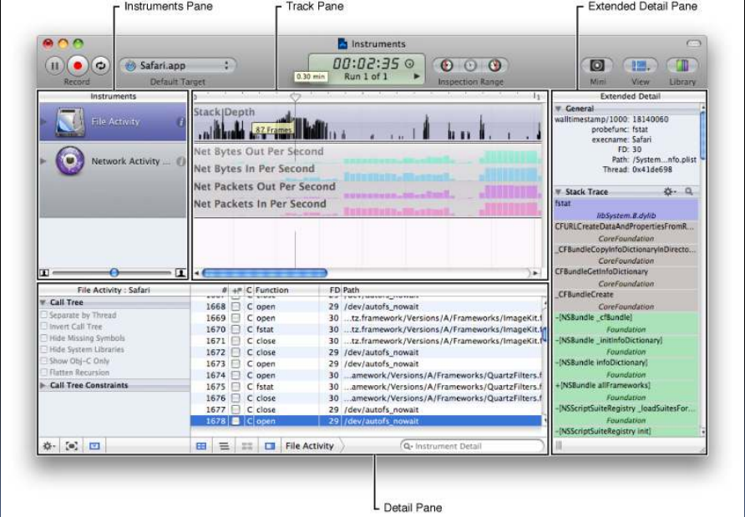
Performance Tools

Slide 13
Power management

Slide 14
Battery Life
Battery life is one of the foundations of mobile technology
  Without it, there is no ‘mobile’!
  That’s why its important to conserve it
  Modern desktop power usage can be in hundreds of watts
  Laptops draw ~50W
  iPhone/iPad draw watts in the low single digits (and lower)

Slide 15
iPhone 3GS Battery
Built-in rechargeable lithium-ion battery
Charging via USB to computer system or power adapter
Talk time: Up to 12 hours on 2GUp to 5 hours on 3G
Standby time: Up to 300 hours
Internet use: Up to 5 hours on 3GUp to 9 hours on Wi-Fi
Video playback: Up to 10 hours
Audio playback: Up to 30 hours

Slide 16
Power Consumption -Radios
Keep in mind that every active hardware module requires power
  Bluetooth
  GPS
  Wifi
  Display
  CPU
Thus if the system is wide away with all radios on, it has a big impact on battery life

Slide 17
Power Management -Modules
Rule of thumb: turn off you don’t need
  eg. Accelerometer
    Remember to stop receiving events set UIAccelerometer delegate = nil
  Enable orientation only if your application needs it
    Enabling orientation means turning on the accelerometer

Slide 18
Power Management -Standby
Without sleep, iPhone’s battery life is adversely affected
  Battery life drops from hundreds of hours to less than twelve without sleep
Don’t disable the idle timer if you don’t need to
  Idle timer kicks in if your application hasn’t had any clicks
Don’t play audio except when you need to
//To disable the idle timer (use this sparingly!)
[UIApplication sharedApplication].isIdleTimerDisabled = YES

